Slide 1

Global Sugar Intake Analysis
CAITLaN Beachey, Amaris hassan, Cecilia leung, Hillary mandich, kapil pundhir

Slide 2
PRESENTATION GUIDELINES
Core Message
Define the Project
Data Exploration
Data Cleanup
Data Analysis
Discussion
Challenges
Additional Findings
Questions

Slide 3

TRIVIAL QUESTION
Do any of you know what your daily sugar intake should be?

Slide 4

BASED ON THE FACTS…
Maximum Amount of Added Sugar to Eat per Day
Men: 37.5 grams or 9 teaspoons
Women: 25 grams or 6 teaspoons
* American Heart Association

Slide 5

CORE MESSAGE
“Your Subway sandwich bread is actually a cake!”
~ Article from the Guardian
Upon reading this article, we wondered what the global average daily sugar consumption and the impacts it has on our health.

Slide 6
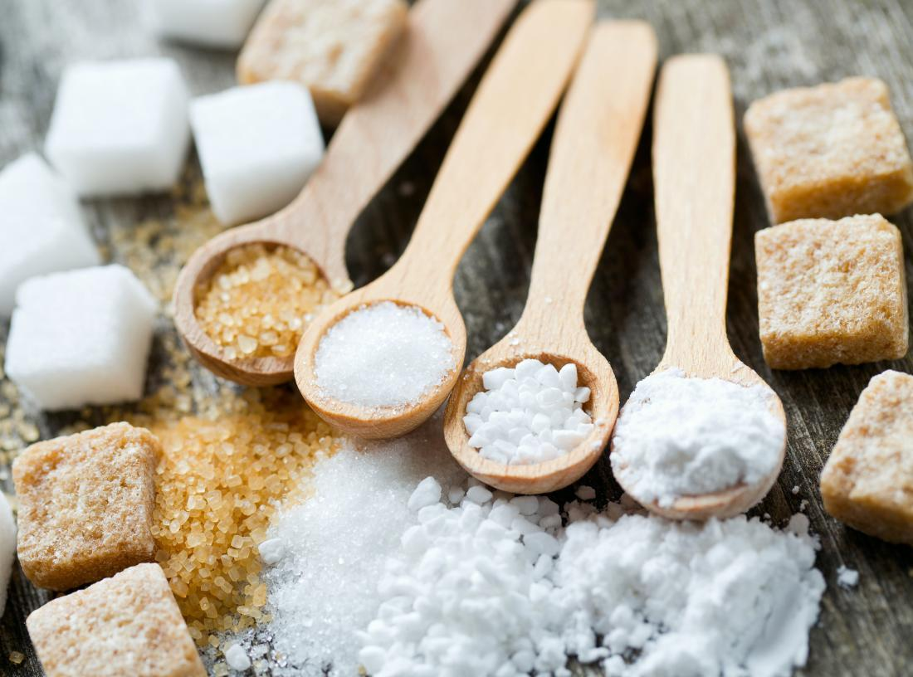
DEFINE THE PROJECT
What is the average daily intake sugar globally? Which countries consume the most on average?
How has the average sugar intake changed over time?
What is the correlation between income and sugar intake?
Is there a correlation between sugar intake and obesity?
Is there a correlation between sugar intake and dental health?
What are the top 5 purchased grocery items in the country with the highest sugar intake? For these 5 top items, what is their sugar content?

Slide 7

SUMMARY OF FINDINGS
Overall, sugar consumption has been increasing globally
US has been the highest sugar intake country for 2011-2013
US has been well above the global average
US grocery data indicates that soda is one of the highest purchased product
The lower the income, the higher the sugar intake
The higher the sugar intake, the higher the obesity rate
Notes:
FIND ANOTHER PICTURE

Slide 8

DATA EXPLORATION
FAO
Kaggle
Kroger Grocery Data
Fat Secret API
Datasets
WHO
World-bank

Slide 9

DATA CLEANUP – INSIGHTS AND DIFFICULTIES
Requires team effort to brainstorm on where to get the data
Time consuming to research the right data for our analysis
Not all information for a specific country may not be available as some of the countries were not independent until 1990-1993
Formats of the Datasets
Requires reformatting CSV files in proper rows and columns
Merging data frames to determine trends and correlation
Complexity of API
Data was hard to retrieve as the sugar content was deeply embedded
Converting data types to conduct analysis

Slide 10

DATA ANALYSIS

Slide 11
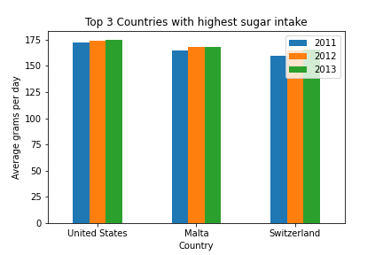
What IS the average daily sugar intake and which countries have the highest sugar consumption?
Results:
USA
Malta
Switzerland
Import Average Sugar Intake csv dataset in Jupyter Notebook and create a data frame.
Filter data to 3 years and sort by descending order for average gram to get countries with highest consumption.
Used Matplotlib method to get bar graphs of the countries with the highest consumption.

Slide 12
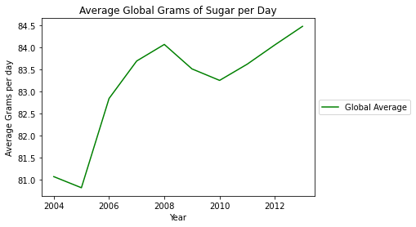
HOW HAS THE AVERAGE SUGAR INTAKE CHANGED OVERTIME?
The trade has shown there has been an increase of sugar intake over the past 10 years.
Import Average Sugar Intake csv dataset in Jupyter Notebook and create a data frame.
Filter data for 10 years and calculate the mean of sugar intake to get the Global Average
Used Matplotlib method to get a line graph to show the trend over the years.

Slide 13
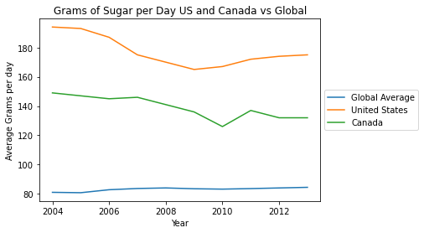
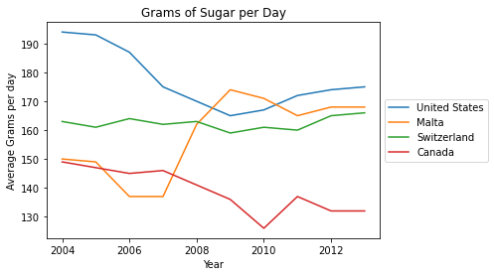
HOW DOES CANADA FARE AGAINST OTHER COUNTRIES?
Canada is still way above the world average.

Slide 14
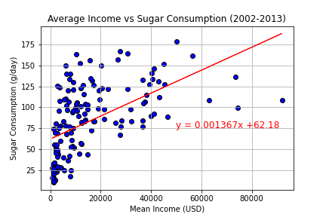
WHAT IS THE CORRELATION BETWEEN INCOME AND SUGAR INTAKE?
Correlation = 0.54
Moderate Correlation
For most cases, average income increases as sugar consumption increases.
Imported the Sugar Intake and Income CSV files.
Conducted an inner merge for the two files together to get all the data in 1 Data Frame.
Did an average of the income over the years between 2002-2013.
Used the Matplotlib method to get the scatterplot and linear regression model to determine if the two factors are correlated.
Notes:
AMARIS TO INPUT HER GRAPH → WILL FIX TONIGHT

Slide 15
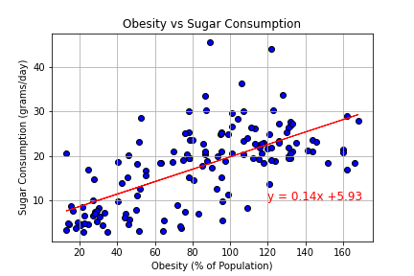
IS THERE A CORRELATION BETWEEN SUGAR INTAKE AND OBESITY?
Correlation = 0.65
Moderate Correlation
For most cases, obesity rate increases as sugar consumption increases.
Imported the Sugar Intake and Obesity CSV files.
Conducted an inner merge for the two files together to get all the data in 1 Data Frame.
Validated the data and ensure there enough samples to do a Scatterplot.
Used the Matplotlib method to get the scatterplot and linear regression model to determine if the two factors are correlated.

Slide 16
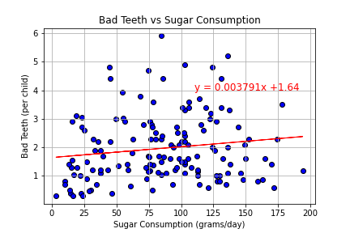
IS THERE A CORRELATION BETWEEN SUGAR INTAKE AND DENTAL HEALTH?
Correlation = 0.14
Weak Correlation
The 2 variables do not have an effect with one another.
Imported the Sugar Intake and Bad Teeth CSV files.
Conducted an inner merge for the two files together to get all the data in 1 Data Frame.
Validated the data and ensure there enough samples to do a Scatterplot.
Used the Matplotlib method to get the scatterplot and linear regression model to determine if the two factors are correlated.
Notes:
Screen shot the linear regression results

Slide 17
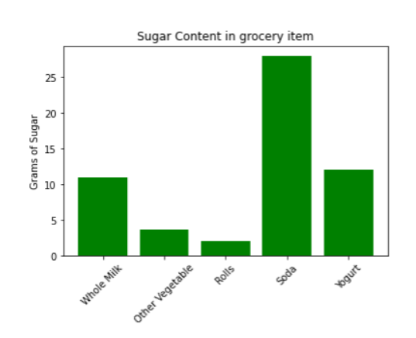
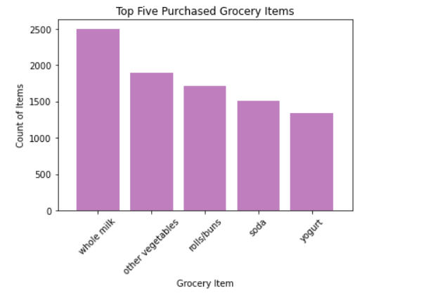
WHAT ARE THE TOP 5 PURCHASED GROCERY ITEMS IN THE COUNTRY WITH THE HIGHEST SUGAR INTAKE?
Aside from the basic food products like Whole Milk, Other Vegetables, Rolls/Buns and Yogurt, Americans purchase a lot of sodas.
Based on the results, soda is high in sugar content.
Imported the Grocery data CSV files.
Groupby Item List to get a count of the most purchased product.
Validated the data to ensure the data is accurate.
Used the Matplotlib method to get the bar graph.
Pulled the API from Fat Secret to get the sugar contents of the products.
API was reviewed and generic product were chosen for each item.
Notes:
Soda size = 1 can

Slide 18

DISCUSSIONS AND FINDINGS
Expected Results:
Increase intake in sugar consumption over the last decade
Lower income households consumes more sugar
High sugar consumption can lead to health impacts like obesity
US is the country with the highest consumption
Unexpected Results:
Bad dental health is not correlated to sugar intake
Malta and Switzerland are in the top 3
Conclusions:
Need to be aware of your sugar intake to maintain a healthy lifestyle
Unhealthy items are lower priced than healthy/organic products
Increasing sugar intake will have negative health impacts

Slide 19

CHALLENGES
Data Collection
Difficulties finding recent data and dataset within the same year
Used more outdated sets then we would have liked
API
No standardization with nutrition labels
Inconsistent data types
Choosing a product that represent a grocery category
Focusing on the Questions
Sugar intake is a broad topic
We narrowed down to the specific factors to look for the information
Notes:
Difficulties – API → Kapil to fill in
Questions – How it has impacts on other disease, how it relates to age, does having a healthy lifestyle affect it?

Slide 20

ADDITIONAL RESEARCH
High Sugar Intake on more Diseases
Sugar Intake by Demographics
Accessibility’s Impact on Sugar Intake
Legislation Impact on Sugar Intake
Notes:
Difficulties – API → Kapil to fill in
Questions – How it has impacts on other disease, how it relates to age, does having a healthy lifestyle affect it?

Slide 21


